Slide 1
Introduction to Testing

Slide 2


Contents
Objectives
  Look at the main testing framework used in Java development
Contents
  MS-Test
  How to set up and run
  Annotations
Hands on lab
  Author Unit Tests

Slide 3
Unit Tests must be…
Automatic
it checks its own results
Repeatable
it can be run again with the same results
Available
it accompanies the code being tested
Notes:
Tests are checked into source control, just like regular code – because they are as much a part of the project as the code

Slide 4
The benefits are really for the developer
You fix all the trivial problems as you go along
You know that they have not recurred
You document without effort, how you see other s/w interfacing with yours
You are able to refactor your code to make it more maintainable, faster... knowing that you haven’t broken anything.

Slide 5
Test Structure
Arrange
Set the starting conditions
Act
Invoke the method being tested
Assert
Decide if the test has passed/failed

Slide 6
Manual Tests
Write a test harness for the Class Under Test (CUT)
Creates instance of class, invokes methods and outputs to console the results
Drawbacks
Not structured; have to hand-craft each time
Not necessarily repeatable; may not work in 2 weeks time
Will not run all the code
No standardised reporting
Requires visual inspection of console output
May miss failures
Integration with other tools (e.g. your build, code coverage)
Notes:
You may see the acronyms
SUT: System Under Test
CUT: Class Under Test

Slide 7
Unit Testing
Unit tests
  Test one unit in isolation
  Also known as Component or Module testing
What is a unit?
  Method
  Class
  Database query or transaction
  Web Page
What are you testing?
  You know the internals of the test – “White Box”
Notes:
Unit Testing is also known as Component or Module Testing. It is a form of “White Box” testing – in other words, where the author of the test has complete knowledge of the internals of the component being tested.
This contrasts with “Black Box” testing, in which only the interface of the component being tested is known and only that interface is tested.

Slide 8
“Family” of testing frameworks
  JUnit for Java, NUnit and MSTest for .NET, Test::Unit for Perl
Simple framework with common design to organise and run tests
  Setup, Test, Assertion, Tear Down
Essential for support of Extreme Programming & Test Driven Development
What is xUnit?

Slide 9
Unit testing method for .NET

Slide 10
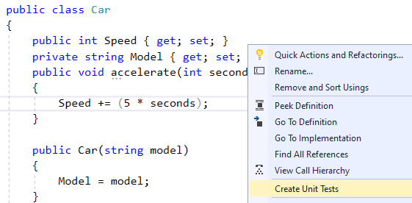
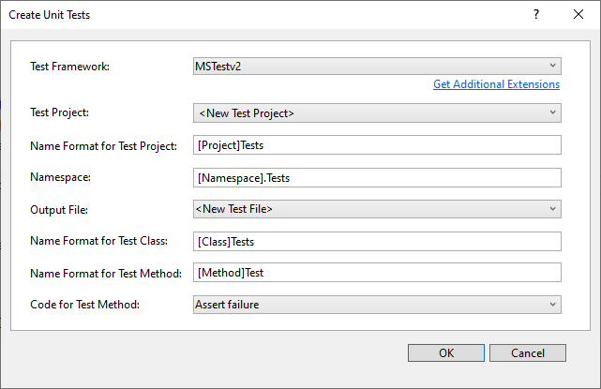
Create a MS-Test project
Right mouse click on a method and then create a unit test project

Slide 11
Write test code
[TestClass()]
public class CarTests {
Car car;
[TestInitialize]
public void SetUp() {
car = new Car("Ford");
}
[TestCleanup]
public void TearDown() {
car = null;
}
[TestMethod()]
public void accelerateTest() {
car.accelerate(10);
Assert.AreEqual(50, car.Speed);
}
}

Slide 12
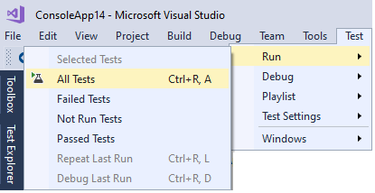
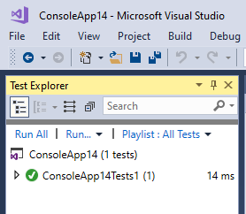
Run the tests

Slide 13
Unit Testing and Test Driven Development are the recommended approach to produce quality software
JUnit encourages the TDD mindset
Review

Slide 14

Unit Testing and Test Driven Development are the recommended approach to produce quality software
JUnit encourages the TDD mindset

Slide 15
Labs
Introduction to testing
Duration 60 minutes

